Slide 1
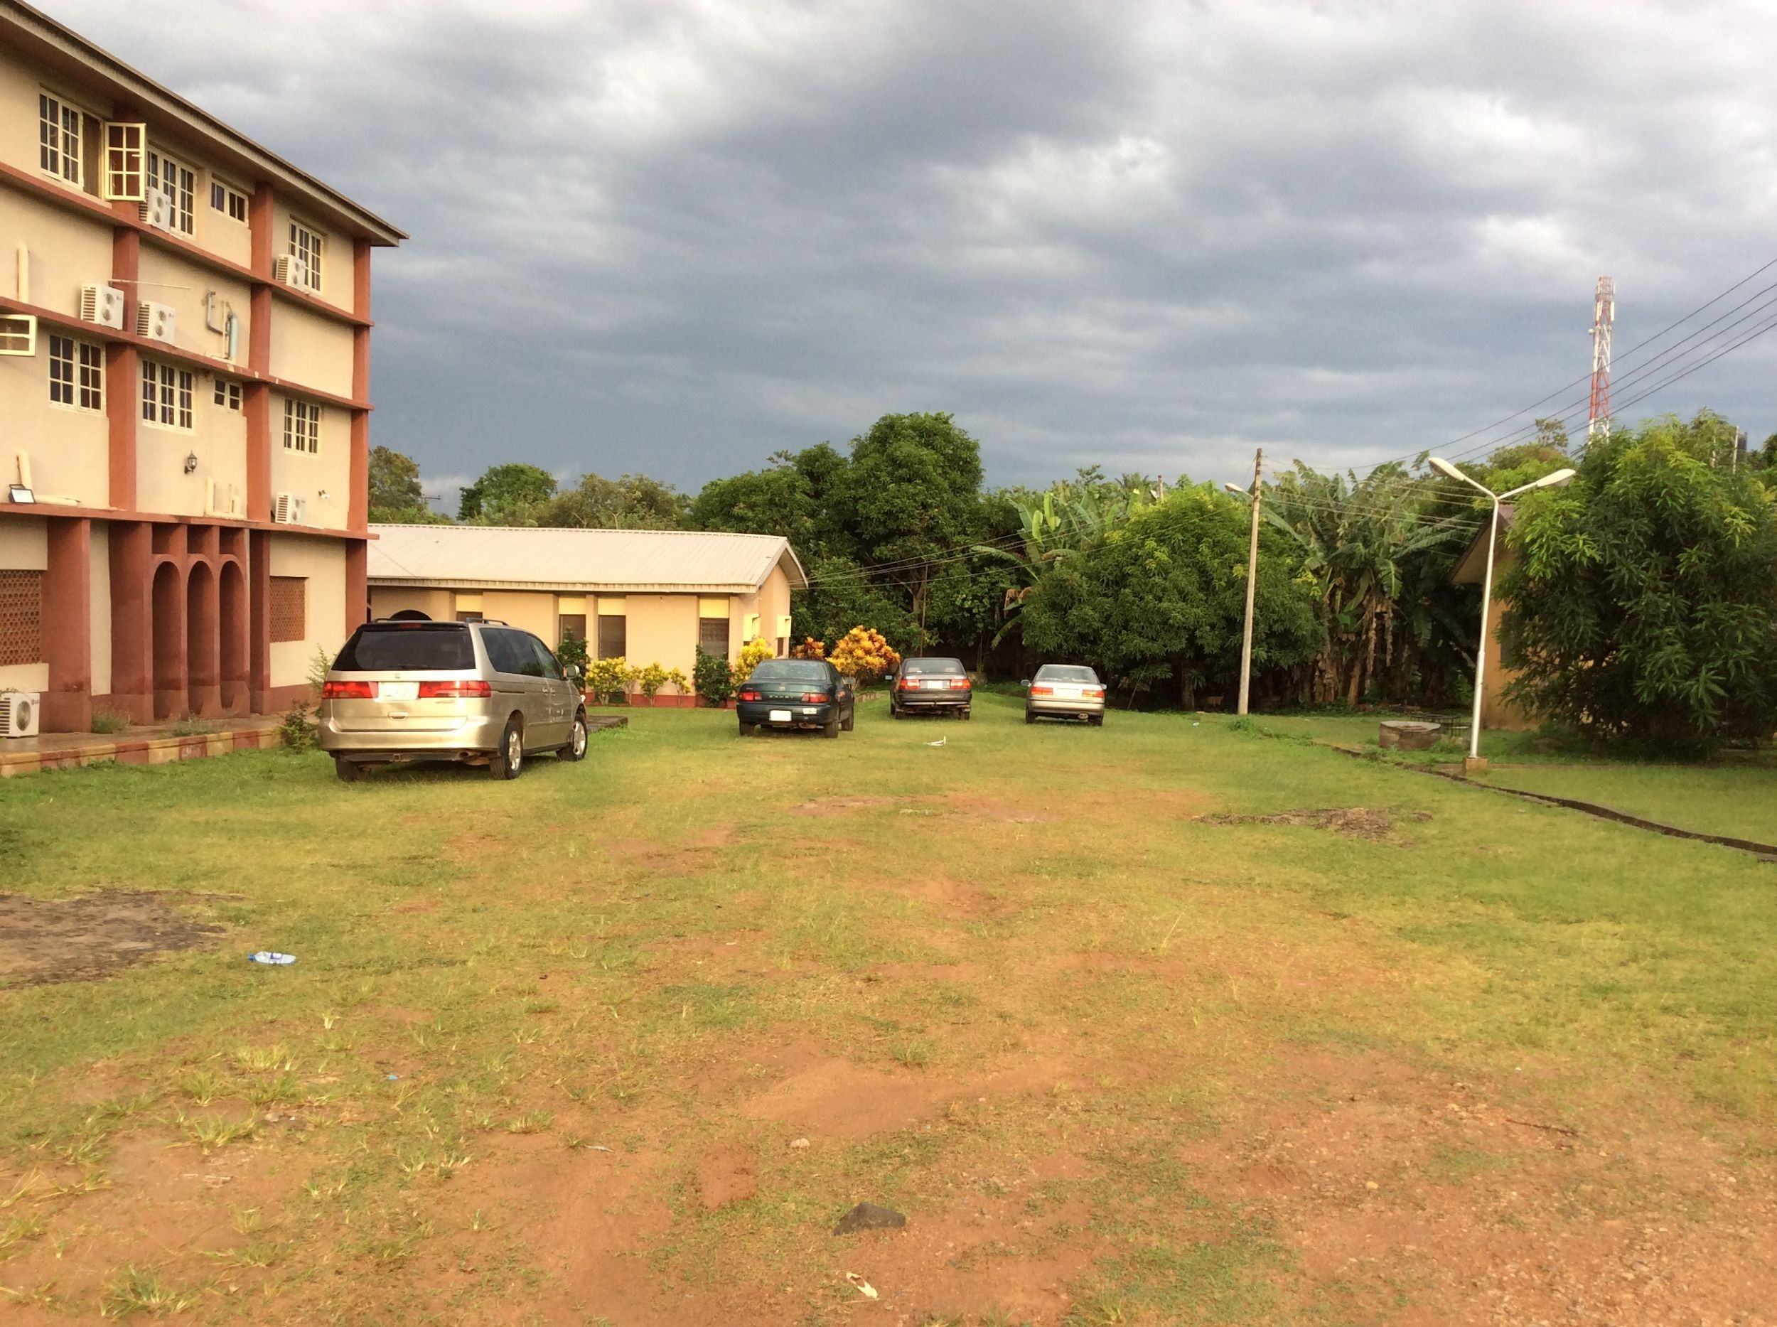
PROPERTY LAW PRACTICE
LEASES 1

Slide 2
Learning Outcomes
At the end of this lesson, students will be able to:
Define a lease.
Identify parties to a lease.
List and explain the different types of leases.
State the difference between a lease and an assignment and a licence.

Slide 3
State the essentials of a valid lease.
Apply principles of a lease to a given case.
Mention types of rents and the factors to consider when fixing rent.

Slide 4
8. State the relevance of a rent review clause.
9. Draft a rent review clause

Slide 5
DEFINITION
It is a contract for exclusive possession and profit of land for some definite period.
Exclusive possession but reversionary interest remains with the Lessor.
Fixed term.
Tenancy if < 3 years

Slide 6
A LEASE refers to:
the Term of Years created, and
the Document creating the term of years
PARTIES
LESSOR
LANDLORD /
/ LESSEE TENANT

Slide 7
A, gives Plot 12 Abi Close, Apo, Abuja to B, for 3½ years at a rent of N1,000,000 per annum, and
A, gives Plot 13 Abi Close, Apo, Abuja to C, for 3 years at a rent of N1,000,000 per annum
Are the legal relationships between A vis B & C the same?

Slide 8
Creation of leases
Written Lease:
A term not exceeding 3 years
S. 4 Statute of Frauds (1677); S. 5 Law Reform (Contracts) Act & Law of Lagos State
Simple tenancy agreement suffices
May be periodic or for a fixed period
Notes:
S. 4 SoF – enforceability of certain contracts unless they in writing & signed by the party to be charged. Eg agreement concerning land, guarantees and contract not to be performed within a year.
S. 4 SoF covers – (a) Promises to pay another’s debt (Guarantees), (b) Contract for the sale of land, (c) Agreements not to be performed within one year.
ESSENCE: (a) Preventing fraud, (b) Ensuring clarity & certainty.
KEYPOINTS: (a) Signed agreement, (b) Memorandum or Note
EXCEPTIONS: (a) When one party has already performed their part of the agreement (b) Admission of oral agreement under oath by the other party.

Slide 9
A.P. Ltd. v Owodunni (1991) 8 NWLR (Pt. 210) 391.
Parole/Oral Lease:
-a term not more than 3 years
-best rent reserved
-lessee conferred exclusive possession
S. 3 Statute of Frauds; S. 79 (2) PCL; Foster v Reeves (1892) 2 Q.B. 255,
Notes:
It must take effect in possession.
b. It must reserve the best rent (not premium or rack rent i.e. the rent must not be paid in advance or in lump sum).
c. It must be for a period not exceeding 3 years.

Slide 10
257
LEASE BY DEED:
-Formal lease under seal
-Term exceeding 3 years
Lease above 3 years created orally or under hand is void for conveying or creating interest in land. S. 77 PCL. Walsh v. Lonsdale – treated as agreement to create a lease
l
Notes:
Section 77(1) PCL states that “all conveyances of land or of any interest therein are void for the purpose of conveying or creating a legal estate unless made by deed”.

Slide 11
INFERENCE OF TENANCY: S. 3 of LSTL, 2011 Tenancy agreement shall be deemed to exist where premises are granted by the landlord to a person for value whether or not it is express or implied, oral or written or for a fixed period.

Slide 12
APPLICATION: LSTL is applicable to all premises within Lagos including business and residential premises
Exception:
Residential premises owned or operated by educational institution for staff and students
Residential premises provided for emergency shelter

Slide 13
iii. Residential premises in a Care or Houspice facility or made available in the course of providing rehalbilitative or therapeutic treatment, or
iv. Premises located in Ikeja GRA, Apapa, Victoria Island and any other area that may exempted by the Governor.

Slide 14
ESSENTIALS OF A VALID LEASE
Certainty of term
- Duration i.e. (Commencement and ending dates)
UBA v Tejumola (1988) 5 SCNJ 173;
Lace v Chantler (1944) 1 KB 363;
Aminu v Nzeribe
- Lease cannot be in perpetuity
Notes:
UBA vs Tejumola – Commencement date of a lease must be specified or be capable of ascertainment.s
Lace v Chantler – a lease ‘for the duration of the war or cessation of hostilities’ was held to fail for uncertainty.

Slide 15
Commencement tied to a future happening or contingency can only be valid upon the happening of the event or the contingency. Okechukwu vs Onuorah & Bosah vs oji – hinged on the issuance of C/O by Onitsha LGC – contingency ascertainable & occurred, the lease were valid.

Slide 16
Proper Mode Of Creation
Statute of Frauds, S. 67 (1) PCL,
Law Reform (Contracts) Act & Law of Lagos State.
LSLRL – Lease to be created by the completion of a prescribed form. Registrar may not register S. 74(3) LSLRL – Reg of Titles determines form
Exclusive Possession
Umezurike v George (1973) 3 CCHCJ
63
Notes:
S. 4 SoF – enforceability of certain contract unless they are in writing and signed by the parties. Without a written & signed agreement (or a memorandum or note thereof) the contract may not be enforceable in court.

Slide 17
Certainty of parties
Parties must have the capacity to sue and be sued and the legal capacity to contract. Idowu v Williams a lease granted to an unregistered religious oorg was held to be invalid
Certainty of property – Yakubu v Kaduna Furniture & Carpets Co. Ltd

Slide 18
Differences Between a Lease and an Assignment
Notes:
S/N
SALE OF LAND
LEASE
An assignment must always be by deed.
Only leases above three years need to be created by deed. Leases three years and below need not be by deed.
Proprietary interest in the property is assigned.
Only a right of occupation and use is passed.
In an assignment, there is no reversionary interest retained by grantor. The entire interest in the property is assigned.
Note: An assignment is the grant of the remainder of the term in a lease Nwanpa v. Nwogu (2006) 2 NWLR Pt 964).
In a lease, grantor has to retain a reversionary interest even if for one day.
Difference in document created. In a contract of sale of land, a formal contract of Sale of Land agreement is created at the contract stage while a Deed of Assignment is created at the completion stage.
In leases above three years, a Deed of Lease is created while in Leases three years and below, a Tenancy agreement is created.
Investigation is compulsory,
Very important to investigate title of the assignor.
Investigation is not necessary
Difference in covenants that binds the parties. Only covenants that touch and concern the land in the head lease will bind the assignee.
Covenants can be introduced to protect the interest of the parties as agreed by the parties. Even where no express covenant is agreed by the parties, they may still be subject of implied or usual covenants by virtue of their transaction or as provided by some written law.
Perfection of title is compulsory
Perfection of title is compulsory
Consideration is mandatory
Rent is not compulsory

Slide 19
Distinguishing factor(s) between a Lease and a Licence
Ishola Williams v Hammond Projects Ltd (1988) 1 NWLR (Pt. 71) 481
Proprietary interest is created, Licence not created.
Certainty of term in Leases not Licence
Notes:
LEASE
LICENCE
Transfer of interest in property.
There is no transfer of interest License
Exclusive possession is essential for a valid Lessee.
A Licensee has no exclusive possessory interest transferable.
The demised estate can survive the death of the lessor.
The death of the licensor terminates the relationship
Lessee can maintain an action in trespass against 3rd parties including Lessor.
A licensee cannot maintain an action in trespass
A lessee is entitled to the statutory notices.
A licensee is not so entitled
Some covenants are implied
Implied terms or covenant do not exist.

Slide 20
RENT
what is Rent? Consideration
a mandatory requirement?
S. 2 of the PCL; Osho v Foreign Finance Corporation (1991) 4 NWLR (Pt. 184) 157 at 168
Types Of Rent
Ground Rent – Bare land
Rack Rent – Full value
Notes:
Rent is the consideration paid by the Tenant/Lessee for the use and enjoyment of the demised property. Rent may be money or money's worth. Rent where agreed must be certain or ascertainable. Rent is not mandatory in leases. The main feature of a lease is lawful occupation by the tenant. Whether the pays regular rent, subsidized rent or no rent at all is immaterial African Petroleum Ltd v. Owodunni (1991)1-12SC I. Note that unless the parties agree otherwise, rent is payable in arrears.

Slide 21
- Premium – lump sum
Factors to consider in charging rent
Condition, Location, Available amenities
Charging of many years rent in advance
implications
remedy/solution: rent review clause
Notes:
a. Inflation: A lessor who collected many years rent in advance may turn out to be at a disadvantage as the value of the money can depreciate as a result of inflation.
b. Tax implications: Rent collected in advance for more than 5 years is subject to tax as a national income-S.4(2)( c) Income Management Act; S.3(3) Personal Income Tax Act.
Legislative restrictions: period for demanding rent & regulate amount of rent. Sec 4(1) & (2) LSTL

Slide 22
Rent Clause
- content: amount of rent due, date of payment, period covered by the rent paid
IMPORTANCE:
Acknowledgement of tenancy relationship
Ascertains rent payable, method & period
Aids enforcement of party’s rights

Slide 23
Rent Review Clause
must be expressly provided
Content of Rent Review Clause
1. Method of initiating the review e.g. a notice in writing to be given by the lessor to the lessee and time within which the notice is to be given.
2. The time frame of the review e.g. after every 5 years of the lease and the date in which the new rent will become payable.
3. The method of calculating the new rent e.g. by expert valuation.

Slide 24
4. Procedure for resolving any dispute of the new rent e.g. ADR
A rent-review clause may be inserted in the reddendum or the reddendum may refer to it in a schedule.

Slide 25
IMPORTANCE
It enables the lessor to maximize profits and returns on investment
It prevents arbitrary increment of rent on the part of the lessor
Guides against conflict
Provides for amicable settlement
Olaniyan v Shokunbi (1997) 6 NWLR
(Pt. 509) 447

Slide 26
The rent reserved in this lease shall be reviewed by the parties every two years during the term granted under the lease or as the parties may agree, provided if the parties fail to reach an agreement on the new rent the rent shall determine by an Estate Valuer appointed by both parties putting into consideration the prevailing rate and the incidence of inflation. Any dispute arising in the course of the review shall be referred to the Multi Door court house.

Slide 27
Ethical Issues
Dedication and devotion – Rule 14 (1) RPC
Bounds of law – Rule 15 RPC
Competency – Rule 16 RPC
Avoid conflict of interest – Rule 17 RPC
Confidentiality – Rule 19 RPC

